Slide 1


Social Buzz

Slide 2


Today's agenda
Project recap
Problem
The Analytics team
Process
Insights
Summary

Slide 3

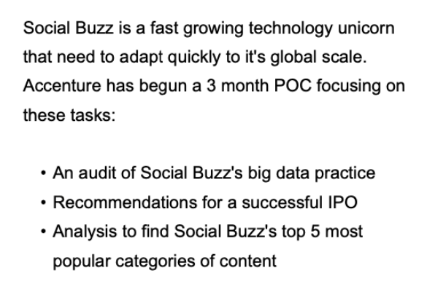
Project Recap

Slide 4


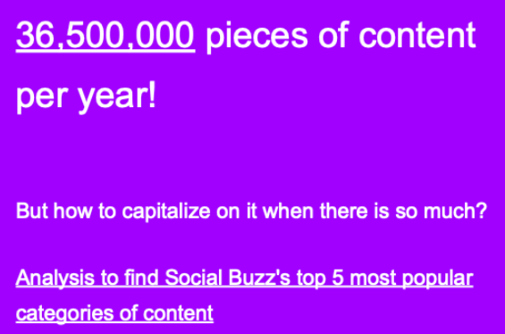
Problem

Slide 5




Prashant kumar
Data Analyst
The Analytics team

Slide 6
Process
1
Data Understanding
2
Data Cleaning
3
Data Modelling
4
Data Analysis
5
Uncover Insights

Slide 7

Insights
Most popular category: Animals
Most post in a month : May(2138)
Total unique categories :16

Slide 10

There are a total of 16 distinct content categories. Out of which Animal and Science categories are the most popular one.
4 type of content – Photo, Video, Gif and Audio,
Out of which people prefer photo and video.
May month has the highest number of posts.
conclusion
Summary
Should focus more on the top 5 categories that’s animal, technology, science, healthy eating and food.
create campaign to specifically target those audiences
Need to maximize in the month of January, may and august as they number of posts in these months are the highest

Slide 11
Thank you!
ANY QUESTIONS?

